Slide 1
Breezy MGS
Group 3
Thomas Baldinger
Rachelle Keller
Yachao Liu
Tymon Necheperenko
Jeongho Yoon

Slide 2
Who are we?
Breezy MGS Consulting Company
Database experts designed to replace old and outdated systems
Strong business background

Slide 3
Ways we can help
Improved tables, forms, and reports
Increase business value
Save time and money
Reducing stress and eliminating confusion

Slide 4
Highlights

Slide 5
Preview Table

Slide 6
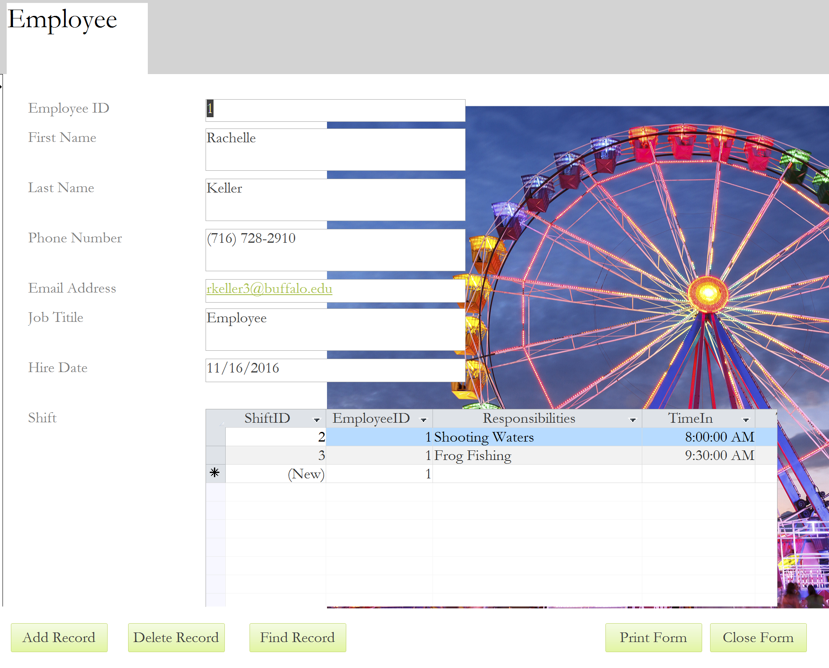
Preview Form

Slide 7
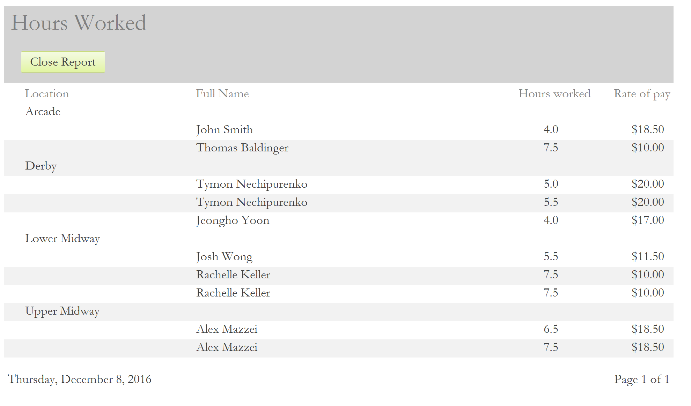
Preview Report

Slide 8
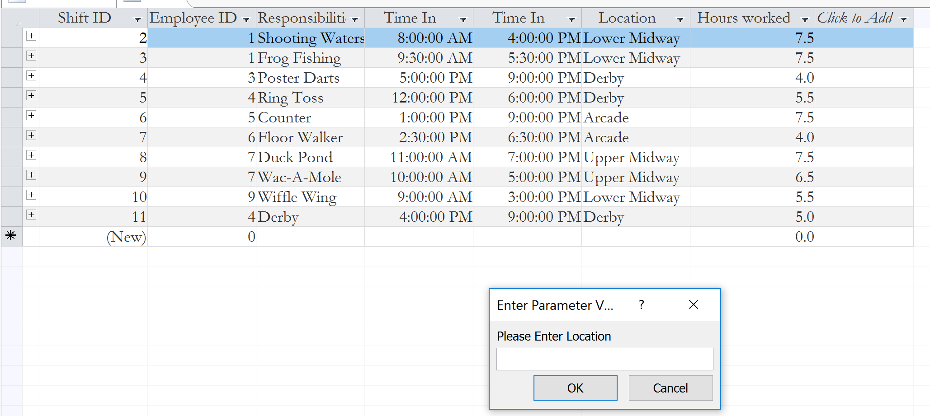
Query-Location Activities
Using this query, managers can easily find out that in certain locations, who are working right now, and can make decisions about are there too many people working at the same location, then they can make change

Slide 9
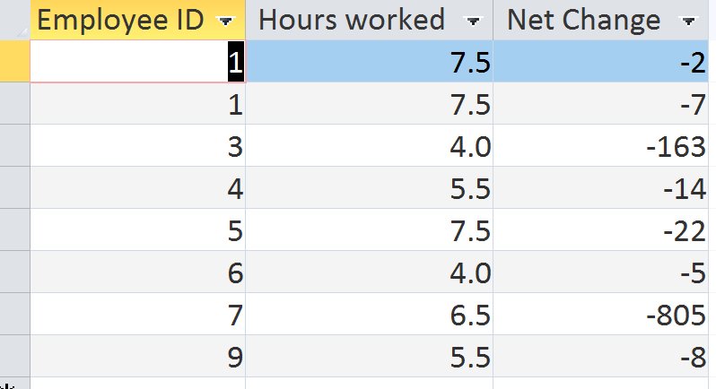
Query - Productivities
Managers can use this query to evaluate employee performance, and can compare the change in the inventory from employee to employee as well as for similar inventory

Slide 10
http://breezymgs.weebly.com/

